Slide 1
Voice Assistants: Future and Challenges
Andreas Kaltenbrunner
Email us: info@ntent.com
Visit us: www.ntent.com
Follow us on Twitter: @withNTENT

Slide 2
Content
Voice Assistants Are Changing Our Lives
NTENT’s Solution
AI-Based Technical Approach
Challenges
Opportunity Summary

Slide 3
Voice Assistants Are Changing Our Lives

Slide 4
Voice Assistants Are Changing Our Lives
Consumers are using their voice to interact with everything: homes, cars, merchants and information providers.
$830M
143M
126M
size of the voice and speech market by 2024
voice-enabled remote controls by 2020
Smart Speakers
by 2020
50%
33%
$40B
of all searches will use voice by 2020
of voice assistant owners plan to make a purchase through voice this year (i.e. Amazon Echo or other voice assistant)
voice shopping revenues by 2020
Sources: OC&C Strategy Consultants, eMarketer, Statista, Gartner
Stats are for US market unless otherwise noted

Slide 5
Voice Assistants Are Changing Our Lives
Consumers are using their voice to interact with everything: homes, cars, merchants and information providers.
A recent Conversational Commerce study by Capgemini predicts that three years from now, 40% of consumers will use a voice assistant instead of a mobile app or website.
Juniper Research expects 55% of U.S. households to own a smart speaker by 2022. Conversational search represents an obvious and exciting advancement in technology.
To meet this demand, the global conversational AI software platform market space is set to expand at an impressive CAGR of +31% from 2019 through 2025.
Ricardo Baeza-Yates, NTENT CTO, Demystifying Conversational AI: What Is It, How Does It Work And Why You Should Care?
Forbes Tech Council, April 2019
https://www.forbes.com/sites/forbestechcouncil/2019/04/16/demystifying-conversational-ai-what-is-it-how-does-it-work-and-why-you-should-care
Notes:
CAGR Compound annual growth rate

Slide 6
NTENT’s Solution

Slide 7
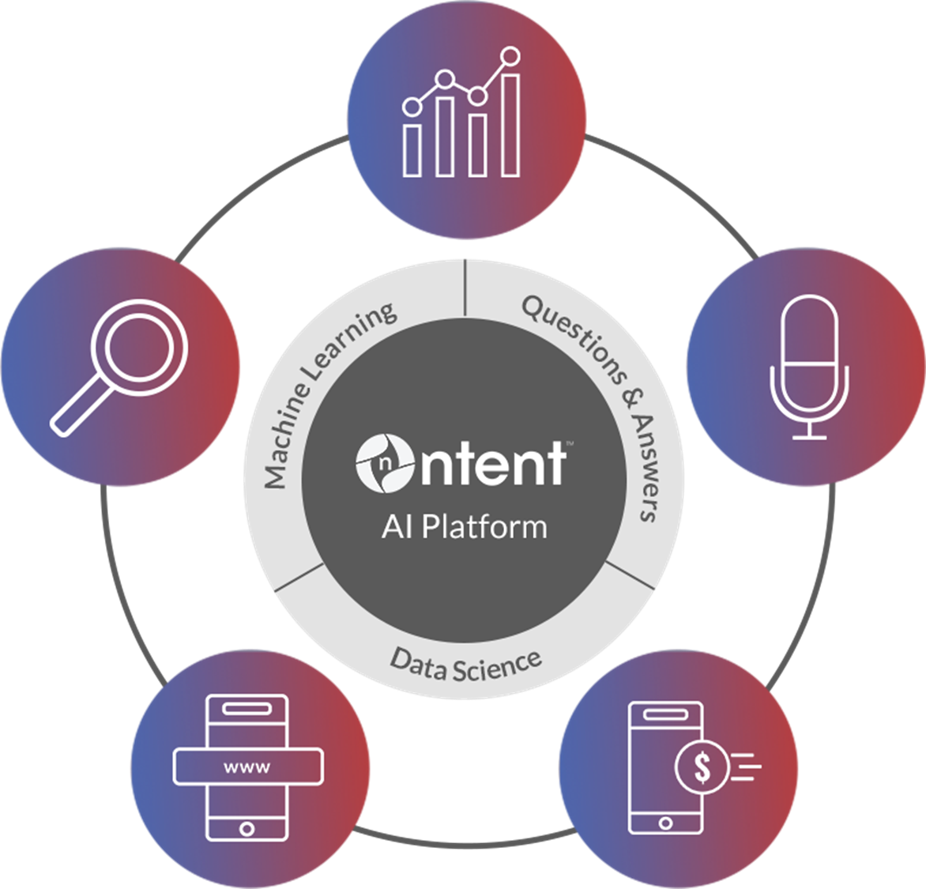
NTENT AI-Powered Search and Voice Assistant Platform
helps enterprises transform customer experiences, drive loyalty and generate revenues by delivering predictive, intelligent solutions – for everyone.
Data & Analytics
Web
Search
Voice
Assistant
Mobile Browser
Ad Monetization

Slide 8
NTENT Voice Assistant & Smart Device Advantage
Differentiators
NTENT gives brands, businesses and app developers the ability to own the entire voice experience, including data, without being beholden to bigger platforms
Why partners choose NTENT vs. the competition?
Fully customizable, voice assistant and white-label smart home device
Localization by geography/language
Retain customer data; NTENT will not use customer data to launch competitive products, unlike Amazon
Ability to select preferred ecommerce provider (no requirement to use big brands, i.e. Google and Amazon)
Create custom “wake” words rather than be beholden to “Alexa”, “Siri”, “Ok Google”
Supports mainstream entertainment systems and devices, being TV’s or set-top-boxes

Slide 9
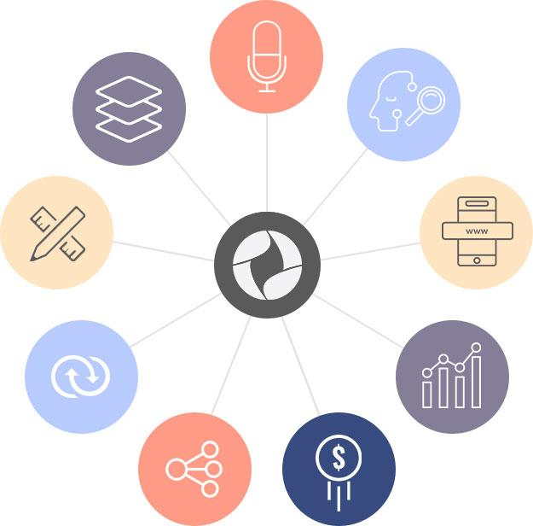
NTENT Voice Assistant Platform
Create natural conversational interactions.
Leverage machine learning to interpret context and answer questions.
Omni-channel platform.
Customizable to your brand and experience.
Web-scale search engine that delivers relevant results
Quickly integrate using pre-built APIs.
Datasets that are unparalleled, laser focused
Intelligent APIs that are scalable and language independent.
Multiple revenue streams: search, voice, video, and content.

Slide 10
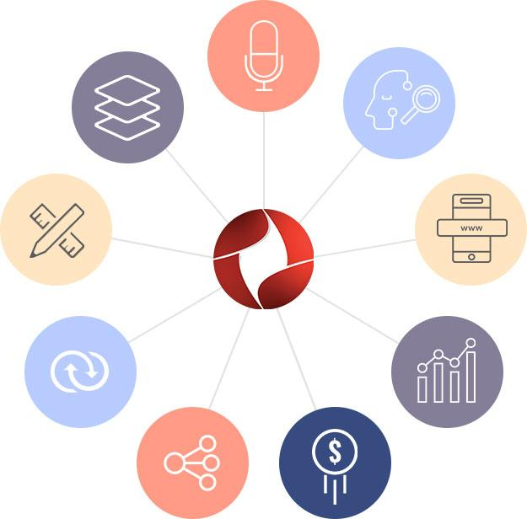
Multiple Voice Assistant Applications
Conversational Interface
At home…
I’m going to Costco, what am I low on?
Turn on my home security system.
In your car…
Where’s the nearest gas station?
Play my morning playlist.
Omni-Channel Platform
Machine
Learning
Customizable
Web-Scale Search
On your phone…
Who built the Empire State Building?
Top up my mobile phone plan.
On your remote…
While watching a TV commercial: Order a large cheese pizza from Pizza Hut Now.
API’s/SDK
Data Analytics
Scalable
Monetizable
While on your Smart TV…
What time is Bill Maher on?
Record Ballers on Monday.
The opportunities are endless...

Slide 11
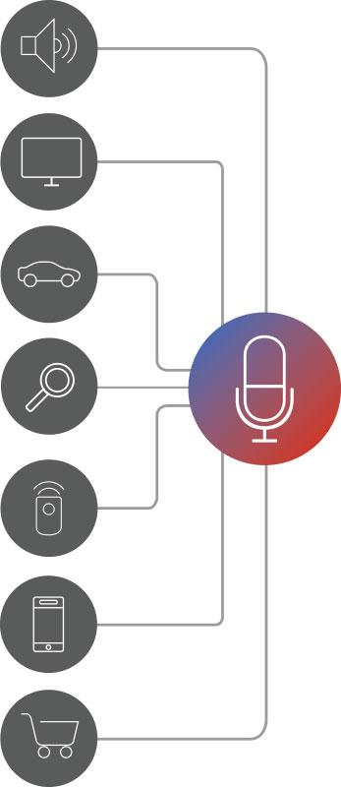
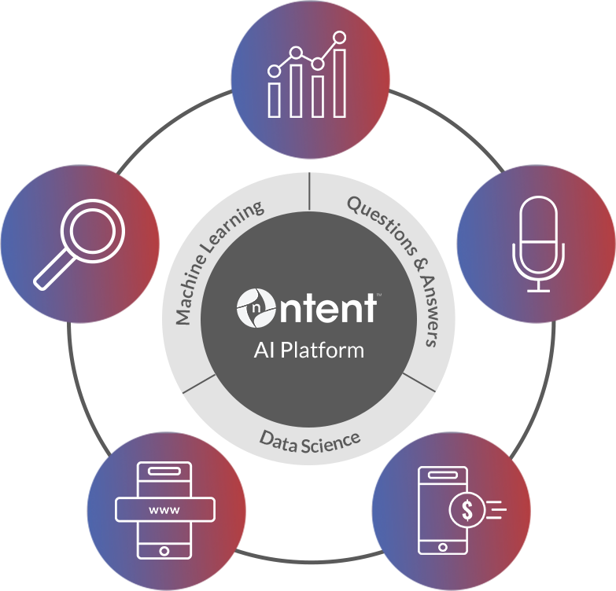
At-A-Glance: NTENT’s White-Label Platform
NTENT-Powered Applications
NTENT Technology Core
NTENT Skill & Capabilities
NTENT Platform
Natural Language Processing
Query Understanding
Knowledge Base
Intent Signals
Applied Data Science
Question and Answer Engine
Location Based Search
Questions & Answers
Points of Interests
Weather
Sports
Wikipedia
Shopping
Food
Travel
News
Command & Control
Movies
Data Analytics
Web Search
Voice
Assistant
Mobile
Browser
Ad
Monetization

Slide 12
AI-Based Technical Approach

Slide 13
NTENT Search and Voice Technology Platform
Robust technology platform ready to power new innovations for your business.
NTENT
Web Search
NTENT
Browser
SDKs for Mobile
NTENT
Video &
Content
NTENT
Gaming &
Rewards
NTENT
Voice Assistant
HTTTP Web API (JSON, XML, Avero
Auth & Access Control Service
Interpretation Engine
Geolocation
Service
Natural Language Processing
Semantic Processing
Artificial Intelligence
NTENT
Ad Platform
User Profile
and History
Decision Engine
Machine Learning Decision Engine
ML Models
web-scale Search Index
Data Logging
Expert Services
3rd Party External Experts
Expert
Data
3rd Party
Data Engine

Slide 14
Voice Assistant Technology Stack
Local to Appliance
Cloud/Server Side
NTENT Engine
Compressed Audio / Audio Features
Machine Learning / AI
Intent Detection
Audio Processing from
Far-Field
Keyword / Wake Word Processing + Model
Abridged Command / Language Processing
Speech / Text Recognition
Language Detection
Slot Filling
Local Device Commands (e.g. Play Song)
3rd Party Data Integrations (Music, Weather, Sports, etc.)
Natural Language Understanding
Experience Customization
Voice Synthesizer
Command / Voice Generation
Dialog Management
Knowledge Graph
Command Executor
User Profiles
Advanced AI Technology deployed in the cloud, edge served to users location where possible for performance
Rapid iteration and unsupervised learning of language. Instant deployment of new data integration and capabilities

Slide 15
NTENT’s Dialogue System High-Level Architecture
Voice(s)
ASR
Text
Normalization
NLU
Intent & Domain Prediction
User Authentication
Dialogue Manager,
Context Tracking &
Pragmatic Adaptation
Slot Filling
User
Model
KB
State & Context
TTS
NLG
Dialogue Response
(Experts)
Action(s)
Notes:
ASR: Automatic speech recognition

Slide 16
Continuous Improvement using AI
Profit from usage data:
Conversations
Context (persona, location, actions, etc.)
Other integrated sensors
Other sources of data
Improve the system performance through:
Better ML models, some online
Better user models
Better context management
Efficiency optimizations
HOME
AUTOMATION

Slide 17
Managing Users’ Expectation (Pragmatic Adaptation)
Key for a truly great user experience
Utterance management
Context consistency
Domain consistency
Dialogue state consistency
Context and domain changes – multiple conversations and users across devices
Ambiguity resolution and, if needed, do not be afraid to ask
Exception handling (silence, noise, sudden context changes, etc.)
Graceful treatment of legal and ethical issues, hate speech, etc.
Overall: use common sense to react as a person (keeping awareness that is not a person!)
HOME
AUTOMATION

Slide 18
Challenges

Slide 19
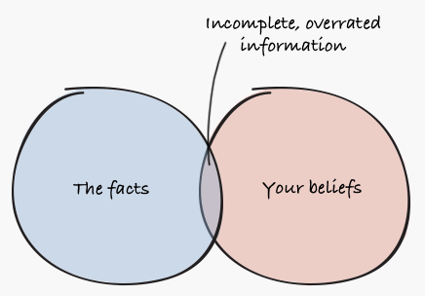
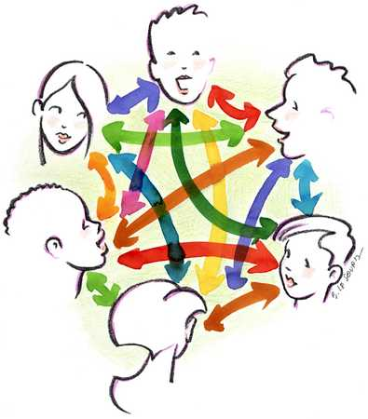
Challenges
Language Diversity
Multiple Conversations
Search Biases
Competing Assistants
HOME
AUTOMATION

Slide 20
Challenge: Language Diversity
According to Ethnologue, about 23 languages are spoken by approximately half the world’s population, but more than 7000 languages exist in total.
Not everyone across the world may have access to a voice assistant or smart speaker, but language differences must be accounted for by machines to properly learn and improve.
Factors such as accents, dialects, slang, pronunciation, words/phrases with more than one meaning and emotional inflections from humor, sarcasm and irony must be discernible.
Language diversity is naturally achieved by increasing the languages handled by the systems, but today, that is driven by potential revenue rather than by the number of native speakers.
HOME
AUTOMATION

Slide 21
Challenge: Multiple Conversations
63% of smart speaker owners place the device in their living room,
⇒ likely to be exposed to multiple people engaged in overlapping conversations.
Voice assistants and smart speakers need to be able to differentiate between who is speaking and detect repetition to avoid recording duplicate data. - Data redundancy and ghost identities will pollute the data in both singular and multiple languages.
Handling multiple people and conversations well requires better identification techniques and improved contextual conversation tracking.
In the case of doubt or when new unregistered people appear, the system could address them directly to resolve any ambiguity.
HOME
AUTOMATION

Slide 22
Search Biases and Competing Assistants
Only 56.8% of the world population has Internet connectivity, and we are still far from reaching a large percentage of them.
Biases in search need to be taken in account: gender, race, politics, religion, etc.
Fake content is also a major problem which needs to be filtered/highlighted.
The percentage of smart-speaker owners who said they owned three or more devices rose to 30% in 2018, but today assistants do not communicate with each other or distinguish well between artificial and human voices.
Multiple assistants means that queries could be counted on numerous devices, resulting in more bias. So we need to recognize the voice of other smart speakers and identify the associated data as non-human.
HOME
AUTOMATION

Slide 23
Dealing with Biases
Awareness is the first step in fighting bias; Your own biases.
Give more control to the user.
Mitigate the bias directly or by using implicit/explicit feedback loops that will inform the search system of issues related to bias.
Ricardo Baeza-Yates, NTENT CTO, Challenges In Conversational AI And What We Can Do To Prevent Them -
Forbes Tech Council, July 2019
https://www.forbes.com/sites/forbestechcouncil/2019/07/30/challenges-in-conversational-ai-and-what-we-can-do-to-prevent-them
HOME
AUTOMATION
NTENT Proprietary Information ©, 2018

Slide 24
Opportunity Summary

Slide 25
What should I do?
Start with a clear and focused use case. Identify aspects of your business that benefit from conversational AI and deliver the highest value to your users.
Decide whether to partner with a major player or use a platform to build your own conversational interface. As you consider near- and long-term strategies, flexibility in how and what you can build, along with who owns the data, will help you decide.
Focus on opportunities to personalize and add value. Users consent to use their personal information in direct correlation to the value they receive by doing so. Create experiences that are worthy of this exchange and keep users engaged.
HOME
AUTOMATION
Ricardo Baeza-Yates, NTENT CTO, Demystifying Conversational AI: What Is It, How Does It Work and
Why You Should Care? - Forbes Tech Council, April 2019
https://www.forbes.com/sites/forbestechcouncil/2019/04/16/demystifying-conversational-ai-what-is-it-how-does-it-work-and-why-you-should-care
NTENT Proprietary Information ©, 2018

Slide 26
Epilogue
As conversational AI evolves, there is no doubt that both consumers and brands will benefit from more intelligent touch points enabled by this technology.
Although your product may not be able to promise the value of a potential partner or soulmate, it can surely offer your customers a reason to fall in love with your brand.
To ensure the playing field stays fair and accurate, businesses will have to incorporate a proactive approach to overcome challenges that prevent long-term growth.
HOME
AUTOMATION
NTENT Proprietary Information ©, 2018

Slide 27
Your Revenues
Grow revenue from search, voice, video
and data
NTENT’s AI-Powered Voice and Search Platform Engineered for your business. Designed to deliver results.
Your Business
Create personalized customer experiences
that increase loyalty
Your Data
Secure behavioral
data insights
Your Customers
Continuously
learn from deep user interactions
NTENT Proprietary Information ©, 2018

Slide 28
THANK YOU!
Andreas Kaltenbrunner
Email us at: info@ntent.com

